Slide 1
Network Analysis of the Chinese Media on the Example of the Hong Kong Protest Movement
Author: Alexandra Bocharova, International Laboratory on World Order and New Regionalism, Research Assistant
Moscow, 2021

Slide 2
The plan of current researсh
Introduction
2. Theoretical foundations of modern China‘s information space analysis
3. The empirical study of China's information space using SNA
4. Conclusion

Slide 3
1. INTRODUCTION
Research Problem
Large number of studies devoted to analyzing the dissemination of information among a Chinese audience (Rauchfleisch & Schäfer, 2014; Yang, 2013; (Ortega, Wang, Olynk, Wu, & Bai, 2012 ) & the specifics of the information policy of the Chinese party media (King, Pan, & Roberts, 2013)
However, a need for a detailed analysis of:
how information is distributed in mainland China and the Hong Kong special administrative region;
how local political crises are covered by traditional Chinese media and local Hong Kong newspapers.
With SNA we will be able to:
illustrate the features of information flows in China on the example of information dissemination about the Hong Kong protests in 2019;
draw conclusions about who sets the information agenda and
how the Chinese and Hong Kong media are interconnected in the context of information policy in China.

Slide 4
1. Introduction
The purpose of the study
to identify the main features of the Chinese media information policy on the example of Hong Kong protests coverage in 2019.
Research tasks include:
analyze how the information about the protests in Hong Kong is distributed in China through the media;
how can we best describe and analyze the network structure of the Chinese media resulting from the study;
develop the mapping of Chinese media information policy and information flows in general.

Slide 5
1. Introduction
Research questions
RQ. What actors (media) play a leading role in shaping China's information policy in the context of the Hong Kong protests?
Additional RQ1: What role do the pro-Hong Kong media play in China’s information space in the context of Hong Kong 2019 protests?
Additional RQ2. What is the structure of the relationship between pro-Beijing and pro-Hong Kong media in China?
Research hypotheses:
H1. Pro-Beijing media are the most cited ones in the context of the Hong Kong protests and, therefore, have the greatest influence on shaping the information agenda in China in the context of resolving the regional crisis.
H2. The media network structure illustrates the strong polarization of pro-Beijing and pro-Hong Kong actors in China's information space.
H3. The main newspaper of the Chinese Communist Party People's Daily acts as an information hub (in terms of betweenness centrality and closeness centrality) in the network of Chinese media.

Slide 6
2. Theoretical foundations of modern China‘s information space analysis
2.1. Information policy conceptualization
«Information policy is comprised of laws, regulations, and doctrinal positions – and other decision making and practices with society-wide constitutive effects – involving information creation, processing, flows, access and use» (Brahman, 2011)
Close linkage of information policy to the political activity intensified in the course of the development of new communication technologies and the emergence of new actors in information policy (Jaeger, 2007; Bimber, 2003).
a potentially democratic online environment space began is regulated in a number of countries, including China, through information control and censorship (King, Pan, & Roberts, 2013; Unver, 2017; Hassard et al., 2007).
However, China is not homogeneous in political governance due to the relative political autonomy of Hong Kong and other autonomous regions of Taiwan and Macau – as a result, we assume that the information policy of the center will differ from the information flows on the “periphery”, that is, in the Hong Kong.

Slide 7
2. Theoretical foundations of modern China‘s information space analysis
2.2. Specific features of the Chinese information space and the information policy of the Chinese media
Six information spheres of Chinese media defined by Austin Luo (2015):
Government (controlled by authorities)
Party (controlled by authorities)
Commercial (partly controlled)
Cultural
Professional (practically not controlled)
Individual (practically not controlled)
Hong Kong information coverage as crisis management (Liu, Lai& Xu, 2017): both informative and ideological aspects (the latter of most importance)

Slide 8
2. Theoretical foundations of modern China‘s information space analysis
2.3. Application of SNA for the analysis of information space and information policy
Co-occurrence of Chinese media:
1) how the information about the protests in Hong Kong is disseminated through the media through mutual quotation
2) the intensity and specific features of the interaction of various Chinese media, both pro-government and regional Hong Kong media (Wasserman & Faust, 1994 )
Four aspects of Chinese media SNA:
Degree centrality: the intensity of interaction between the Chinese media and with foreign media;
Actor closeness centrality: to what extent a particular information source interacts with other media based on the level of clusterisation (Balevas, 1950);
Betweenness centrality: the importance of particular media as a link between several media clusters in China (Linton, 1977);
Eigenvector centrality: the importance of a particular media in shaping the information agenda for Hong Kong protests and public reaction coverage (Newman, 2006).

Slide 9
3. The empirical study of China's information space using SNA
3.1.1. Research design and data collection
For the period from 12 June – 12 December 2019 all references to other media (both national and foreign) were collected among media news of biggest and most influential Chinese and Hong Kong media, including:
16 Chinese pro-Beijng media;
9 Hong Kong newspapers;
References to 18 foreign newspapers and information agencies.
directed graph to highlight more accurate relationships between Chinese media;
node size of each media - the volume of citations of the given newspaper by other sources

Slide 10
The fragment of adjacency matrix of Chinese, Hong Kong and foreign media during the period of 12 June – 12 August 2019
12 June 2019 - 12 December 2019 | Global Times | Xinhua | The Paper | China News | CCTV | Renmin Ribao | Junbao Jizhe (Military Reporter) | Guang Ming Daily
Global Times |  | 196 | 19 | 28 | 166 | 73 | 4 | 7
Xinhua | 0 |  | 0 | 0 | 0 | 0 | 0 | 0
The Paper | 0 | 38 |  | 0 | 0 | 0 | 0 | 0
China News | 10 | 61 | 0 |  | 43 | 34 | 0 | 10
CCTV
Renmin Ribao | 5 | 167 | 0 | 0 | 5 |  | 0 | 0
Junbao Jizhe (Military Reporter) | 0 | 93 | 0 | 0 | 0 | 84 |  | 0
Guang Ming Daily | 0 | 16 | 0 | 31 | 0 | 0 | 0 | 0
China Youth Daily | 0 | 47 | 0 | 0 | 35 | 53 | 0 | 0
International Sharp Review
China Focus | 48 | 0 | 0 | 0 | 45 | 0 | 0 | 0
China Women's News | 0 | 40 | 0 | 0 | 0 | 67 | 0 | 0
Haiwai Wang (People's Daily) | 0 | 59 | 0 | 0 | 0 | 101 | 0 | 0
China Daily | 0 | 0 | 0 | 0 | 0 | 5 | 0 | 0
South China Morning Post | 16 | 15 | 0 | 0 | 16 | 13 | 0 | 0

Slide 11
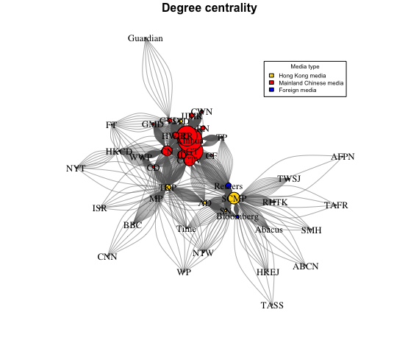
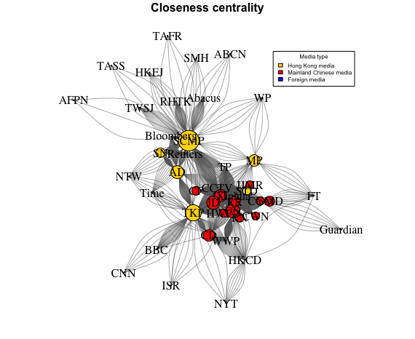
3. The empirical study of China's information space using SNA
3.1.2. SNA: Connection network creation and centralities calculation

Slide 12
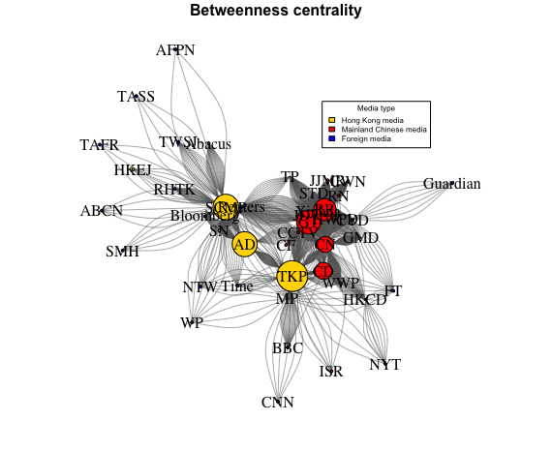
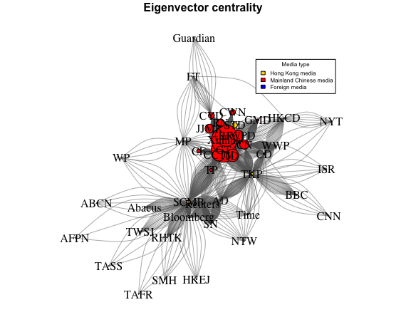
3. The empirical study of China's information space using SNA
3.1.2. SNA: Connection network creation and centralities calculation

Slide 13
3.1.2. SNA: Connection network creation and centralities calculation
Media Abbreviation | Media | Degree Centrality | Closeness Centrality | Betweenness Centrality | Eigenvector Centrality
GT | Global Times | 806 | 0,0088 | 224,5561 | 0,9569
Xinhua | Xinhua | 905 | 0,0006 | 0 | 1
TP | The Paper | 68 | 0,0006 | 4,3418 | 0,1177
CN | China News | 377 | 0,0106 | 152,6498 | 0,3612
CCTV | CCTV | 424 | 0,0006 | 0 | 0,4675
RR | Renmin Ribao | 759 | 0,0078 | 209,6416 | 0,8353
JJMR | Junbao Jizhe (Military Reporter) | 181 | 0,006 | 0 | 0,3468
GMD | Guang Ming Daily | 68 | 0,0075 | 0,6282 | 0,0796
CYD | China Youth Daily | 160 | 0,0062 | 23,1375 | 0,2348
ISR | International Sharp Review | 7 | 0,0006 | 0 | 0,0053
CF | China Focus | 97 | 0,0065 | 0 | 0,147
CWN | China Women's News | 110 | 0,006 | 0 | 0,2052
HWPD | Haiwai Wang (People's Daily) | 245 | 0,006 | 0 | 0,4149
CD | China Daily | 96 | 0,0086 | 160,2714 | 0,0659
SCMP | South China Morning Post | 439 | 0,0154 | 241,9049 | 0,1259
Reuters | Reuters | 204 | 0,0006 | 0 | 0,0439
Bloomberg | Bloomberg | 111 | 0,0006 | 0 | 0,0244
AD | Apple Daily | 124 | 0,0096 | 235,9049 | 0,0284
AFPN | AFP News agency (France) | 3 | 0,0006 | 0 | 0,0008
JD | Jiefang Daily | 308 | 0,0099 | 1,5297 | 0,4877
TKP | Ta Kung Pao | 220 | 0,012 | 291,4349 | 0,1239
Time | Times | 19 | 0,0006 | 0 | 0,0043
SN | Stand News | 91 | 0,007 | 0 | 0,0091

Slide 14
3. The empirical study of China's information space using SNA
3.2. Results of the study
H1. There is a dominance of the alliance of state media in the information policy of China – confirmed
H2. The media network structure illustrates the strong polarization of pro-Beijing and pro-Hong Kong actors in China's information space – partly confirmed
H3. The main newspaper of the Chinese Communist Party People's Daily acts as an information hub (in terms of betweenness centrality and closeness centrality) in the network of Chinese media - rejected

Slide 15
4. Conclusion and scope of future Research
The results obtained in this study are of scientific novelty, since they partially refute the existing theoretical and empirical studies on the existence of Beijing's complete control over the information sphere, the most significant elements of which are the print media.
Mapping information flows in a short period on the issue of the protest movement may become representative of the "crisis management" policy of the Chinese government
Research limitations: only Internet versions of official newspapers, no microblogs or social network activities considered; we also did not estimate the effect of outer media on the domestic audience
Future research: current research is based on the comparative analysis of Chinese government’s crisis management policies in dealing with crises of political and non-political nature (Hong Kong protests vs. Covid-19 crisis 1st wave)

Slide 16
References
Rauchfleisch A., Schäfer M. (2014) Multiple public spheres of Weibo: a typology of forms and potentials of online public spheres in China. Information, Communication & Society, Volume 18, Issue 2, pp. 139-155.
Yang G. (2013). The power of the Internet in China: Citizen activism online. New York: Columbia University Press.
King G., Pan J., Roberts M. (2013). How censorship in China allows government criticism but silences collective expression.
Braman, S. (2011). Defining Information Policy. Journal of Information Policy, vol.1, 1-5.
Jaeger P. (2007). Information policy, information access, and democratic participation: The national and international implications of the Bush administration’s information politics. Government Information Quarterly, 24 (2007), 840–859.
Bimber, B. (2003). Information and American democracy: Technology in the evolution of political power. New York: Cambridge University Press.\
Austin J. (2015). Media system in China: a Chinese perspective.
Liu W., Lai C. et al. (2018) Tweeting about emergency: A semantic network analysis of government organizations’ social media messaging during Hurricane Harvey // public Relations Review, Volume 44, Issue 5, 807-819.
Wasserman, S., & Faust, K. (1994). Structural analysis in the social sciences. Social network analysis: Methods and applications. Cambridge University Press.
Bavelas, A. (1950). Communication patterns in task-oriented groups. Journal of the Acoustical Society of America, 22, 725–730.
Linton F. (1971). A Set of Measures of Centrality Based on Betweenness. Sociometry, 40(1), 35-41.
Newman M. (2006). Modularity and community structure in networks. PNAS June 6, 2006 103 (23) 8577-8582.

Slide 17
Network Analysis of the Chinese Media on the Example of the Hong Kong Protest Movement
Author: Alexandra Bocharova, International Laboratory on World Order and New Regionalism, Research Assistant
Moscow, 2021

